Slide 1



Last Minute
WOOF
A Real-Time AI Fraud Detection
Trust the furry

Slide 2



THE REAL-TIME
PROBLEM FACING
The Critical Problem: Transnational Cybercrime
Fraud is now organized cybercrime, leveraging AI Voice Cloning and Deepfakes
RM1.9B
74%
Losses Reported
Malaysians Exposed

Slide 3

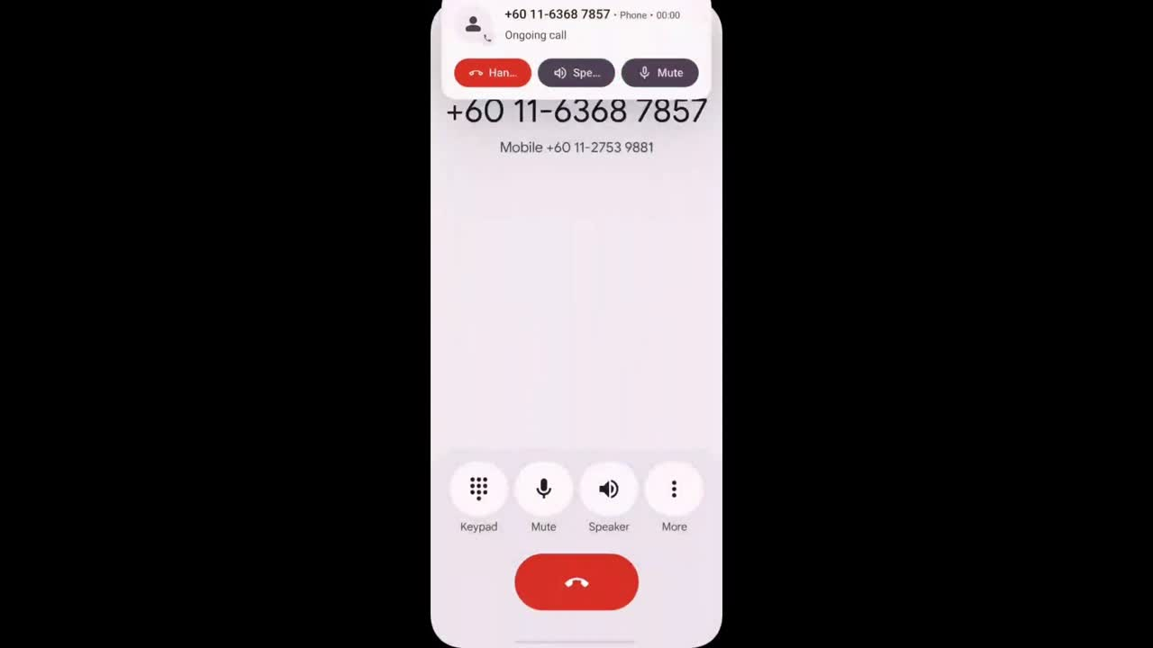


About
Conclusion

Slide 4
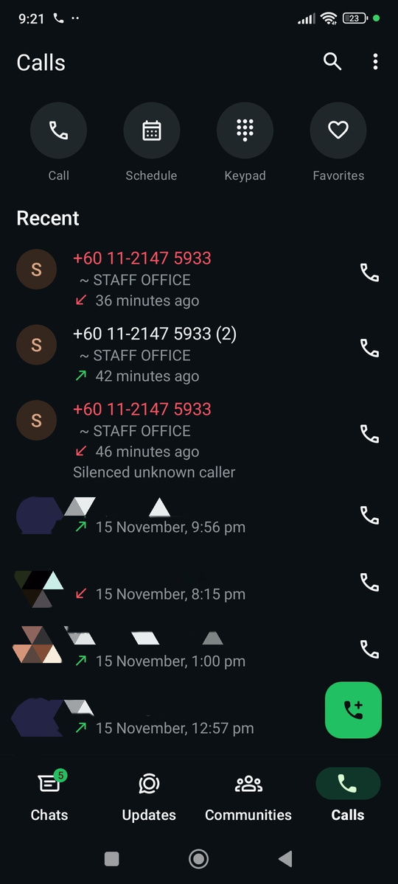
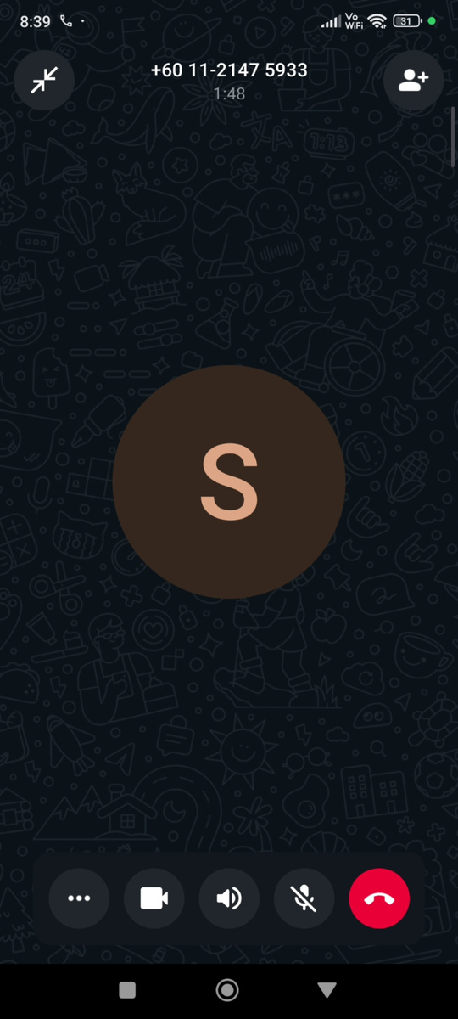
SCAM IN MALAYSIA

Slide 5

OUR MOTIVATION
The Technical Failure
Old systems are bringing knives to an AI gunfight. They only alert after the manipulation. We are here to fix the inadequacy.
Why WOOF?
To build an AI-Fraud detector
Restore trust in our digital lives

Slide 6

AI-Powered
Real-Time Detection
Cross-Platform Content Analysis
OUR
SOLUTION-WOOF
Explainable & Adaptable Defense

Slide 7
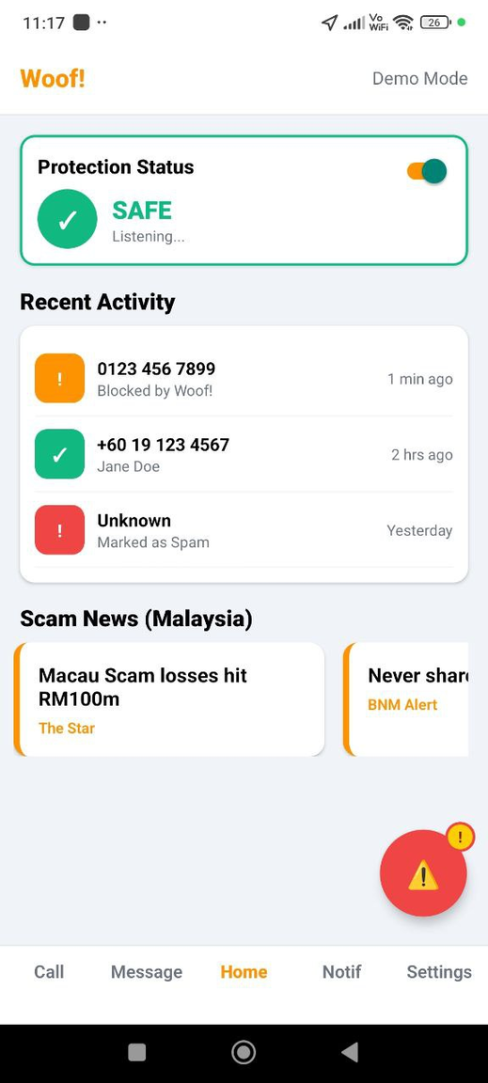
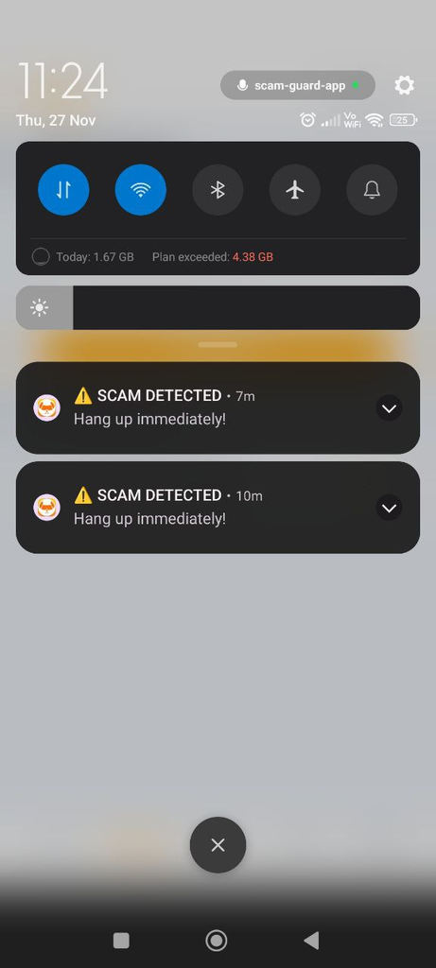
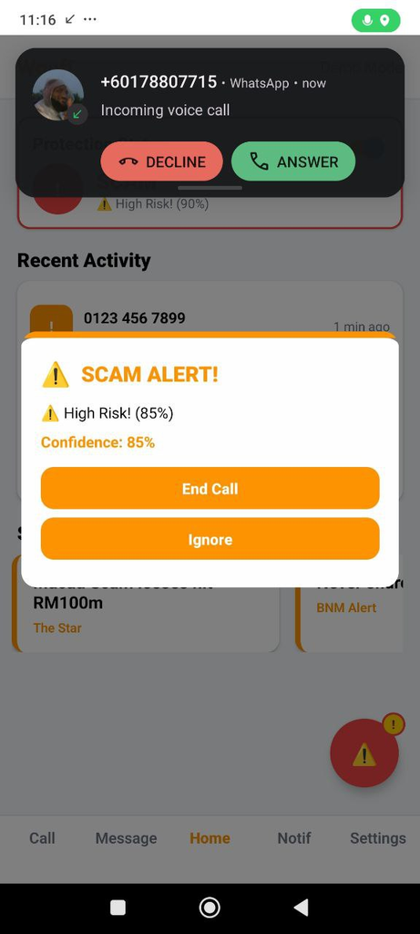
USER JOURNEY
WOOF

Slide 8


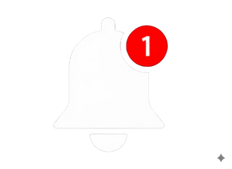
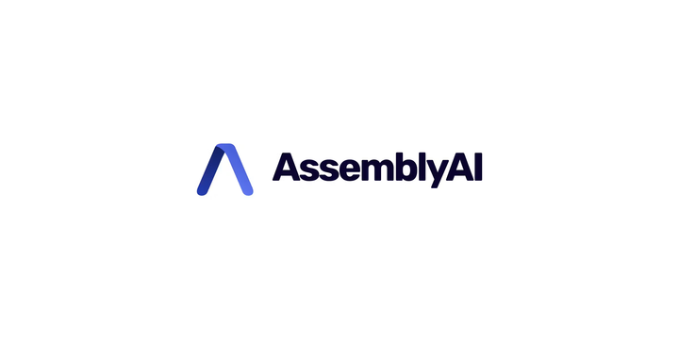





SYSTEM ARCHITECTURE
Out APP
In APP
High risk
Jam AI based
+
Notifications
Audio Tracking
Data
(backend)
Safety Status
(frontend)
+
IDLE
Data analysis
Multi-langauge Analysis
Low risk

Slide 9
WOOF TECH STACK
Component
Tools & APIs
Frontend & Data Capture
React Native
ELLM Qwen3 (30B-A3B, 2507)
ELLM Qwen2 Audio(7B)
AssemblyAi
Core AI & Processing
Backend & Deployment
Python (Backend Logic/Processing)
JamAI Base (Database)

Slide 10
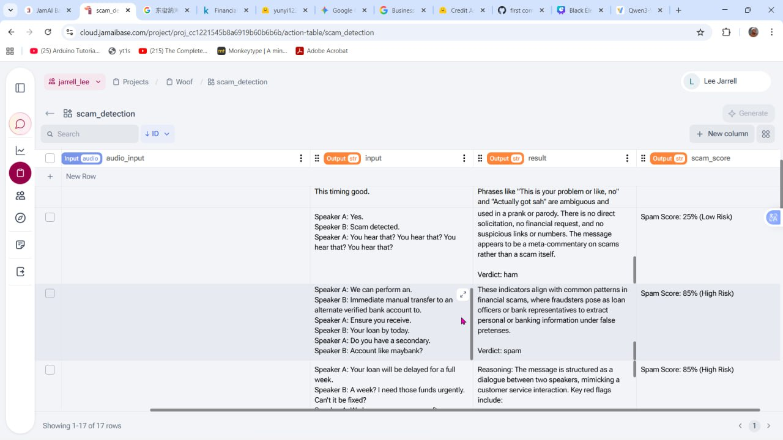
DATABASE

Slide 11
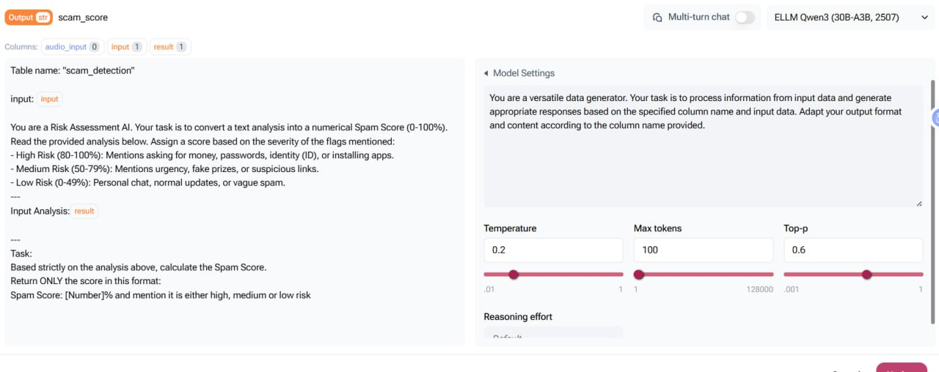
DATABASE

Slide 12
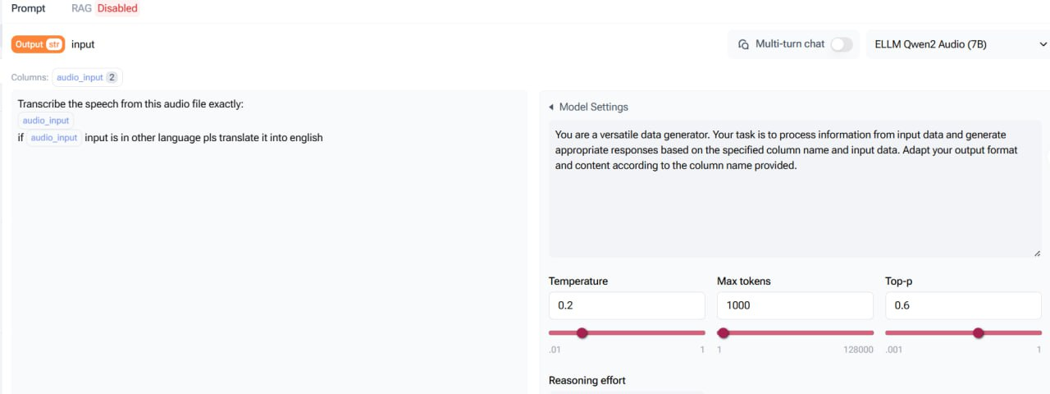
DATABASE

Slide 13
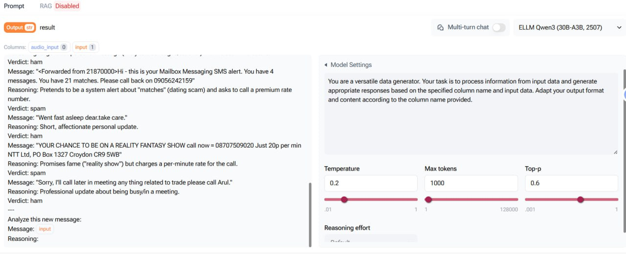
DATABASE

Slide 14
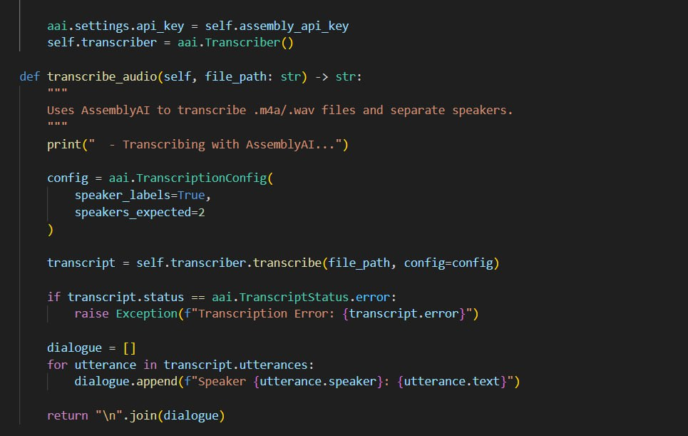
DATABASE

Slide 15




TARGET USER
The WOOF Fix
Paradigm Shifting
Reactive Reporting ->
Proactive Defense
Normal Users (B2C)
Small Businesses (B2B)
Protection for personal savings and identity.
SaaS model for secure internal transactions.

Slide 16
COMPETITIVE FEATURE ANALYSIS
Feature
WOOF
Truecaller
Whoscall
Detection Timing
✔ Real-Time (Content)
✘ Pre-Call (ID only)
✘ Pre-call / Real-Time (Hybrid)
AI Content Scan (Intent)
✘ No
✔ Jam AI LLM
✘ Basic Rule-Based Prediction
Message/SMS Scanning
✔ Cross Platform
✘ Limited
✘ Limited Link Scan Only
Data Source
✔ Proprietary LLM & Custom Data
✘ Crowdsourced Database
✘ External Partner Dependent

Slide 17
MARKET & GROWTH
STRATEGY
Market Validation
Financial Projection (3-Year)
$200B+
Year 1 Launch & B2B Pilot RM 1.5M
Global Fraud Prevention Market (2032)
Year 2 Scale (500K Users) RM 7.5M
APAC
Year 3 Regional Expansion RM 25M
Fastest Growing Region (20% CAGR)

Slide 18
FUTURE PLAN
Phase 1: Deep Penetration
0 - 18 Months
Phase 2: Regional Domination
18 Months - 3 Years
Phase 3: Digital Guardian
3+ Years
Goal :
500K users in Malaysia
Focus :
Launch B2B SaaS & Active LLM Learning
Goal :
Expand to APAC (Target : RM25M)
Focus :
WOOF API for Banks & App-Chat Monitoring
Goal :
Regional Standard for Secure Digital Identity
Focus :
Integrate Deepfake Video Analysis

Slide 19


IMPACT OF WOOF
SDG 8: Decent Work
and Economic Growth
SDG 16: Peace, Justice, and
Strong Institutions:
Restoring Trust & Stability
Rebuilds trust by creating a secure digital space
Protecting Jobs
B2B solution reduces this financial danger
Keeps economy stable and preserves jobs
Protects money of individuals & SMEs
Protects financial stability

Slide 20
FAQ: LEGALITY & PRIVACY
Q: YOU GUARANTEE PRIVACY AND AVOID VIOLATING WIRETAPPING/RECORDING LAWS?
Q: HOW WILL YOU ACQUIRE ENOUGH LABELED DATA TO SCALE THE LLM?
`
A: Yes. User Consent is mandatory. Woof maintains Zero
Storage Policy, deleting raw audio and transcripts after
analysis. Only anonymized vectors are stored (PDPA
compliant).
A: Strategic Government Collaboration. We seek data-
sharing agreements with MCMC and NSRC on real-
world scam dialogues, ensuring continuous AI
improvement.

Slide 21
FAQ: MODEL & DATA
Q: WHAT ABOUT FALSE POSITIVES?
Q: WHY JAM AI?
A: We use a Two-Step Verification:
High-precision Al Score + Whitelist check
against verified businesses to prevent flagging legitimate
calls.
A: Specialization and Custom Data for high-precision
features.

Slide 22
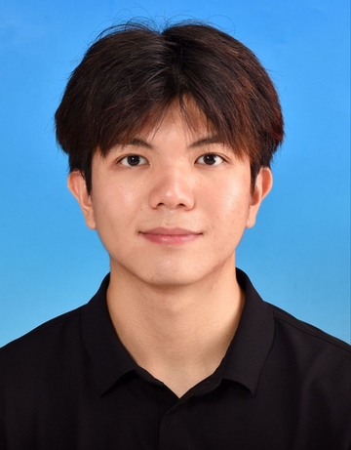
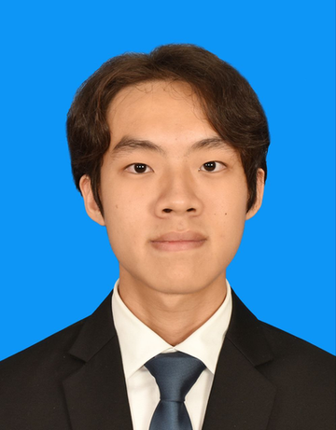
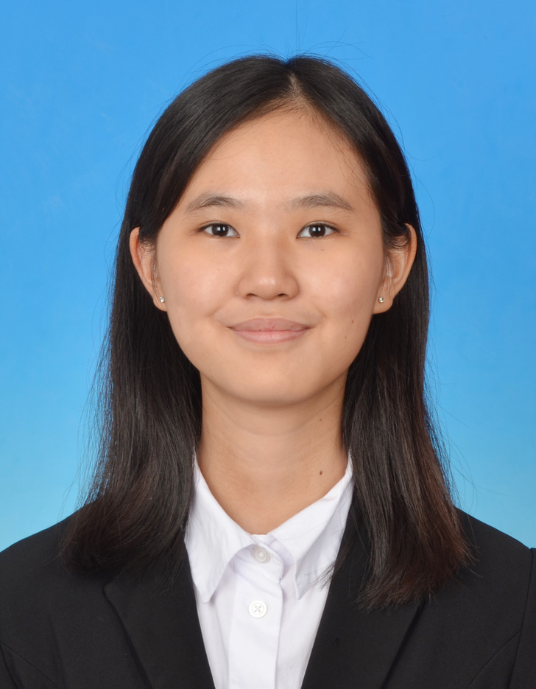
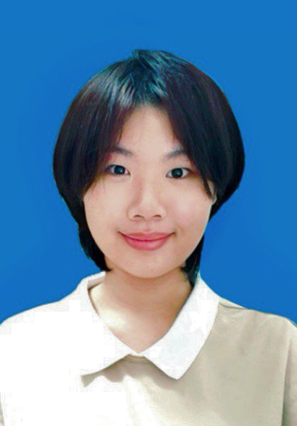
MEET THE TEAM
LEE JARRELL
LOO JIUN WEI
JANISA GOH SHI JIE
ANGEL TAN
KE QIN
Lead Developer
Chief Executive Officer
Lead Researcher
Lead Desginer

Slide 23
REFERENCES:
Fortune Business Insights: Global FDP Market Size (2025-2030)
Fortune Business Insights: Fraud Detection and Prevention Market Size, Share & Industry Analysis, By Solution (Fraud Analytics, Authentication and Governance, Risk and Compliance), By Application (Insurance Claims, Money Laundering, Electronic Payment, and Others), By Deployment (On-Premise and Cloud), By Enterprise Type (Large Enterprises and Small & Medium Enterprises (SMEs)), By Industry (BFSI, IT and Telecom, Retail and Consumer Packaged Goods, Government, Construction and Real Estate, Energy and Utilities, Travel and Transportation, Healthcare and Life Sciences, and Others), and Regional Forecast, 2025-2032

Slide 24
Trust the furry
THANKS!
WOOF protects every call, every voice, every person.
Presented by “Last Minute”

